Slide 1
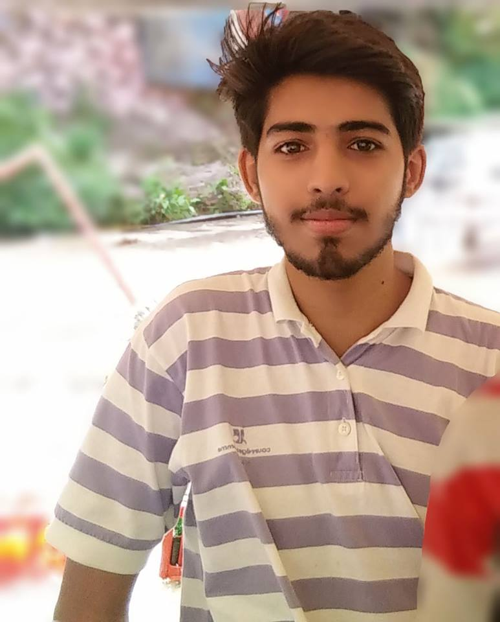
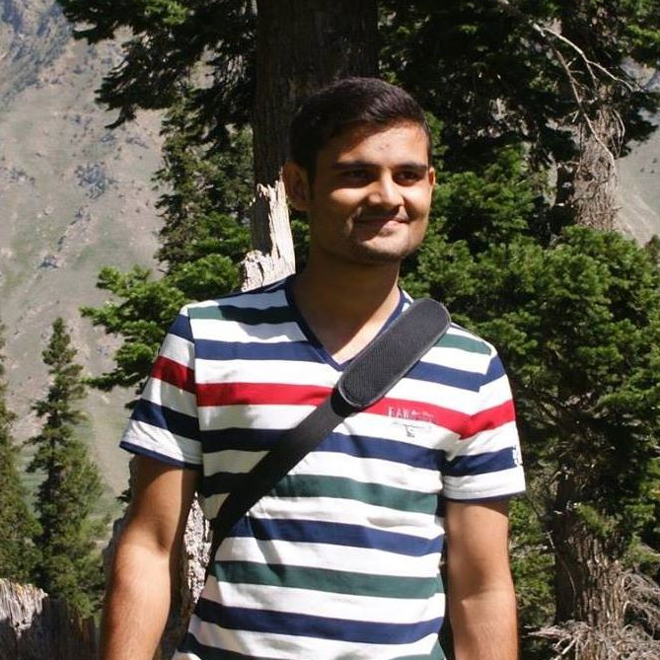
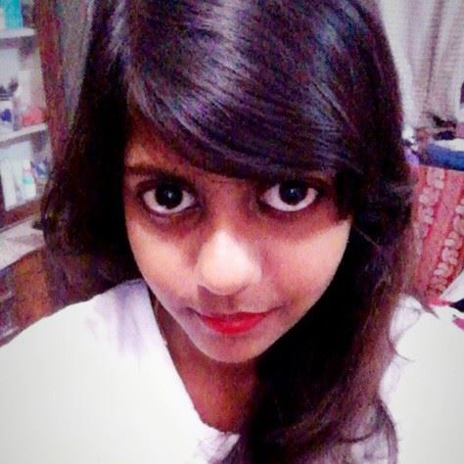
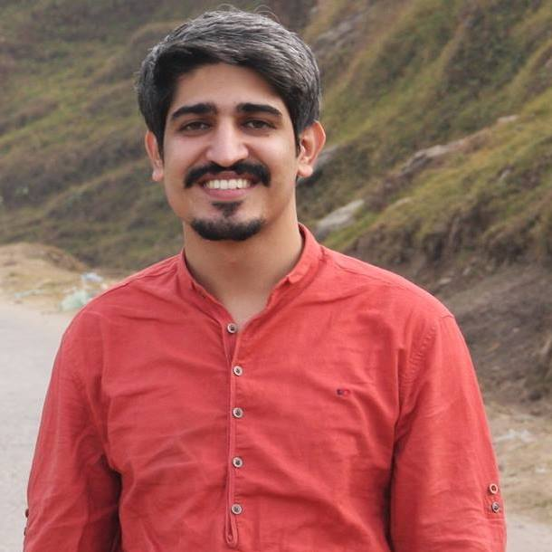
Restaurant Ranking Application
AAzaz ul haq(BSCS13068)
Hamza Javed (BSCS13061)
Maham Johnson (BSCS13052)
Muhammad Zubair (BSCS13038)

Slide 2
Problem Domain
Working to promote local restaurants and food chains.

Slide 3
Initial POV
Restaurants want an app so they can get more customers
customers want an app to rate food, get good suggestions as to where to dine out
Customers also want to have home delivery of local food.

Slide 4
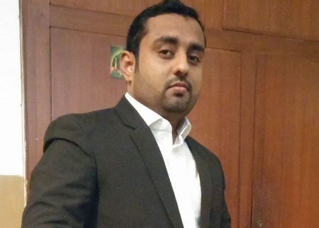
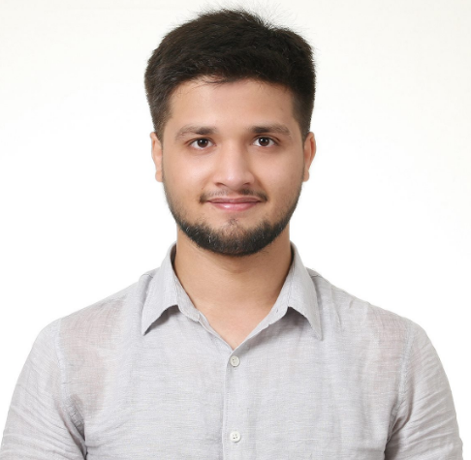
Interview and findings
Adil Rafique- customer
he is fond of dining out and prefers local food over branded food.
He wants to have and app that will provide hygienic details of a restaurant.
He was very much interested in our idea.
Ali Abduallah- customer
He goes out for food with friends and family.
quality of food and price matters to him much.
already using Food Panda, EatOye.
He wants one such app that will promote local food too so he will have diverse options to before eating.

Slide 5

Interview and findings
Owner of Bismillah Restaurant- Provider
His restaurant serves fast food as well as desi food.
He thinks his restaurant is going good.
He thinks identity on social media is wastage of resources.
He wants to grow his business but he needs more information about what we are planning to do.
Sumbal Maqbool- customer
She goes less out and prefers junk food over desi food.
environment matters and prefer to go highly rated restaurant.
She would like to have a platform where she would get a list of local and branded food chains with their list of food they offer, price and rating.

Slide 6
Revised POV’s
Customer needs feedbacks from the people who’ve already tasted food of a particular chain so he knows if it’s worth spending money or not

Slide 7
Revised POV’s
Customer needs more a platform that will give him price list along with items so he can decide what to eat looking at his budget and will give him discount offers on his frequent use of that platform.

Slide 8
Revised POV’s
Owner of Bismillah Foods needs a platform that will be in his native language so that he will face no hardship in using it .and easily get order using that platform.

Slide 9
Best Three HMW’s
Pov1 : How might we insist customers to join a platform and be active on it?
Pov2 : How might we convince food chains to allow us to share their item list on a platform?
Pov3 : How might we make sure from time to time that user is making success in learning the same platform and is having no issue?

Slide 10
Prototypes1:
Sign up : abc@gmail.com
User name : ABCD
Password: 123456
Pop up message:You can order free food of 100 Rs for the first time

Slide 11
Assumption: People will attract to our app to get their first food free
Testing prototype: We tell our features to people and they like our idea most of the people said that they will love to use this app
Validity: People were happy to install our app to get first time free food .We decided that we will give free food (different incentive)to the limited customers per month. Depending upon the type of response we get

Slide 12
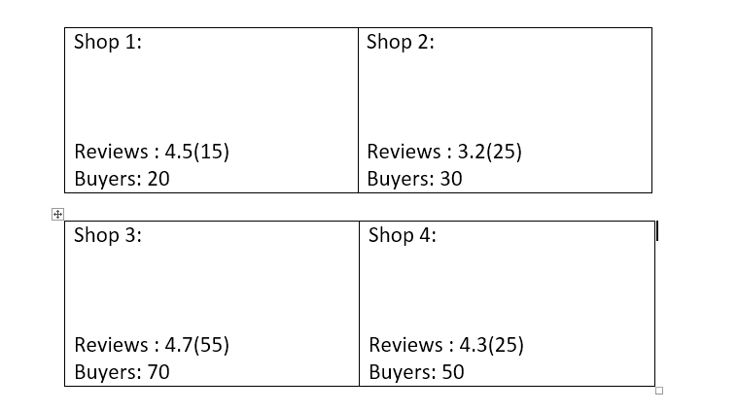
Prototype2:

Slide 13
Assumption: Restaurant owners will love to join on our platform when they will see their competitors are already on our platform.
Testing prototype: We showed them our prototype, shared our idea and named the big brands which already have their own app but still it was really difficult for us to convince them that what benefits they can from our app
Validity: They want to join us if it really increase their customers .

Slide 14
Prototype3:
Review our app : 4.5/5
Feed back : ------------------------------------------------------
Assumption: People will give feedback after using our app and we will use this data to improve our app.
Testing prototype: We asked different people that will they give feedback if such app existed?
Validity: Yes, people love to give feed back and review .

Slide 15
Thank You …
Questions ???

